Slide 1
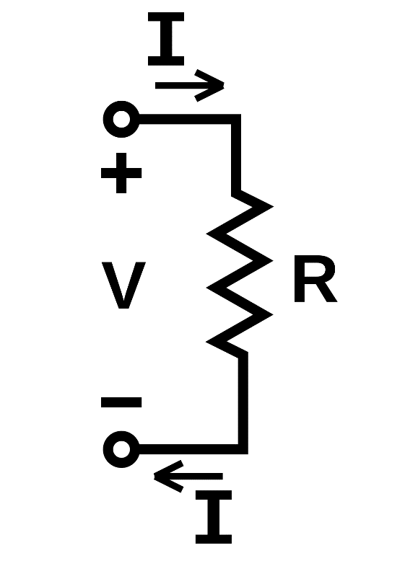
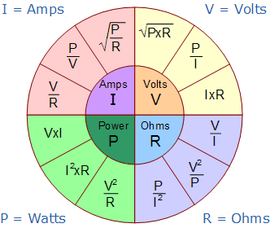
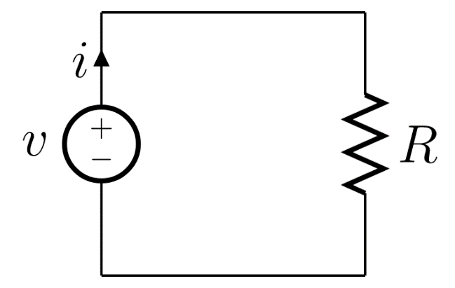
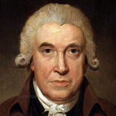
Voltage, Current, Resistance
Current
Ohm's Law
Volts
Resistance
$$V=IR$$
A Circuit
Schematic
James Watt
(1736 – 1819)
Joules (Energy) per second

Slide 2
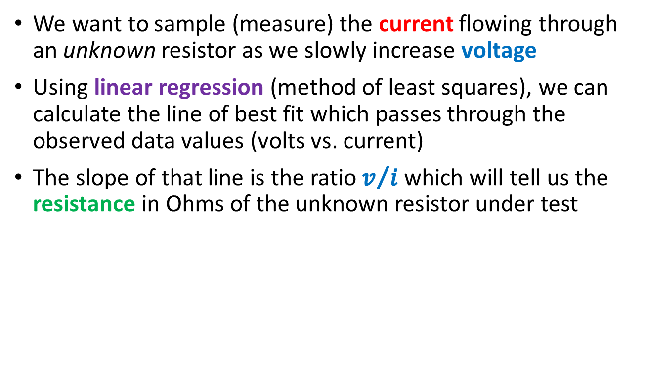
Walking in Ohm's Footsteps
We want to sample (measure) the current flowing through an unknown resistor as we slowly increase voltage
Using linear regression (method of least squares), we can calculate the line of best fit which passes through the observed data values (volts vs. current)
The slope of that line is the ratio $v/i$ which will tell us the resistance in Ohms of the unknown resistor under test

Slide 3
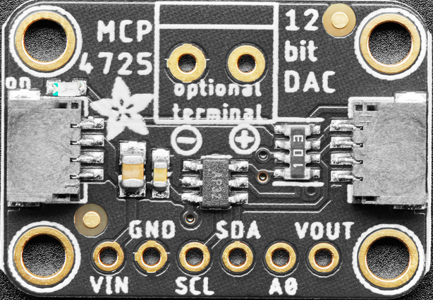
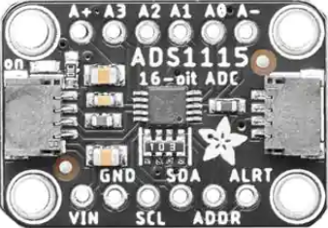
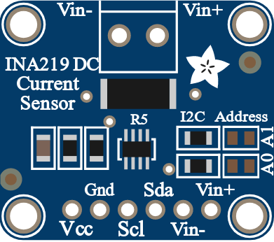
Walking in Ohm's Footsteps
The KB2040 does not have a DAC, (only an ADC) so we will command the Adafruit MCP4725 12-bit DAC using the I²C protocol
The KB2040 built-in ADC is only 10-bits (4,096 distinct voltage levels) so we will control the Adafruit ADS1115 16-bit ADC using I²C
The INA219 DC Current Sensor can measure up to +26V @ 3.2 Amps with less than 1% error and also uses I²C to communicate

Slide 4
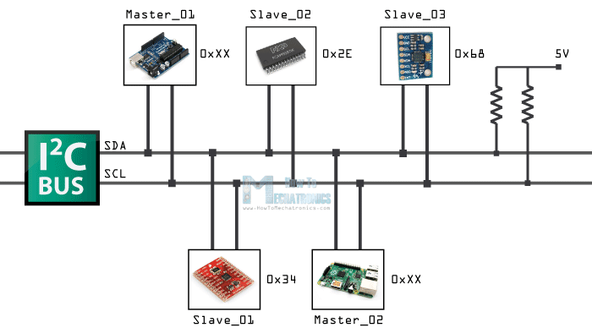
The I²C Bus Protocol
Every device on the bus needs to have a unique address
Controller_01
Peripheral_02
Peripheral_03
SDA = Serial Data
SCL = Serial Clock
The I²C bus only needs two wires
Peripheral_01
Controller_02

Slide 5

Initial Design
To KB2040
All devices on the I2C bus have their respective SDA and SCL pins connected
All Vin and GND pins are connected to the power rails
The Vout pin of MCP4725 DAC provides voltage to the resistor
The differential inputs A0 and A1 of the ADS1115 ADC allow measuring the voltage drop across the resistor
The Vin- input pin on the INA219 sensor can read the current flowing through the resistor

Slide 6

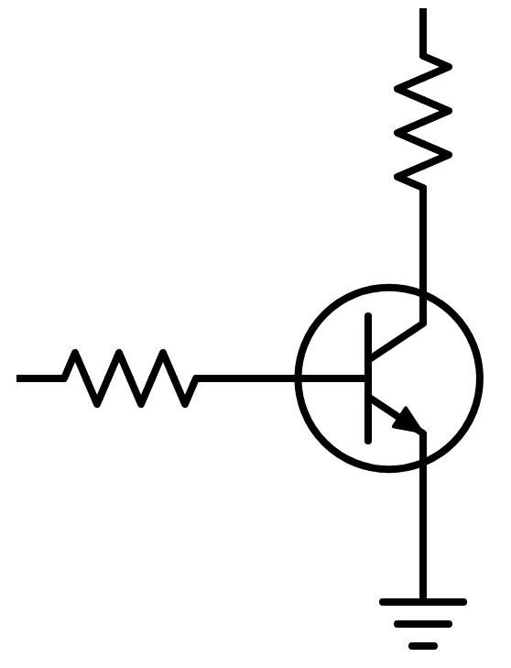

The Bipolar Junction Transistor (NPN)
To Current Sensor
Vcc = +3.3V
HIGH (A0)
To the ADC
Unknown Resistor
$$R=\frac{V_{R}}{I_{C}}$$
LOW (A1)
Collector
1.5V → 2.5V
@ 800mA
From the DAC
Base
PN2222A NPN BJT
0.68V → 0.76V
@ 14.5mA
330Ω
Current Limiting
(BJT are diodes)
Emitter
GND
Common Emitter Configuration
GND

Slide 7
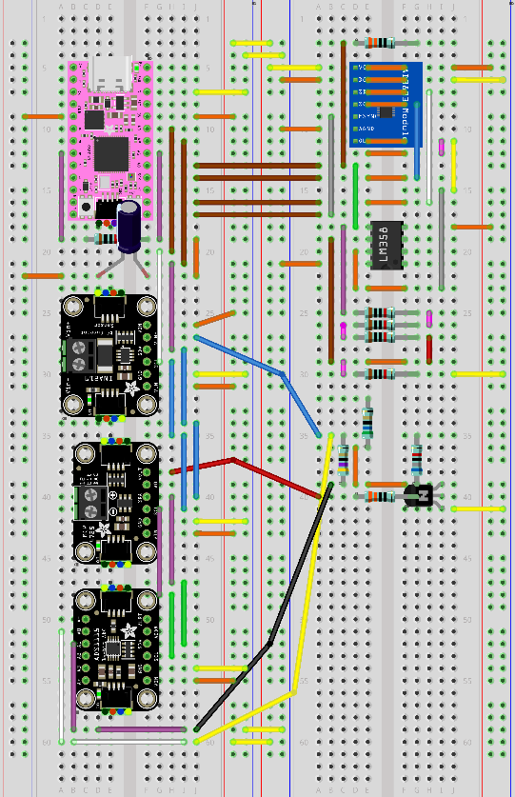
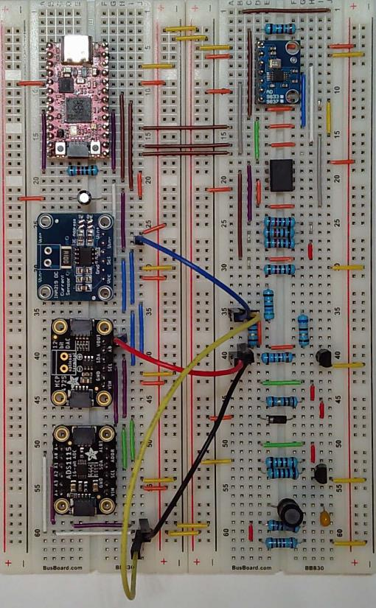
Step 28a – 47Ω Resistor
(1) Blue Flexible Jumper
(1) Yellow Flexible Jumper
(1) Red Flexible Jumper
(1) Black Flexible Jumper

Slide 8
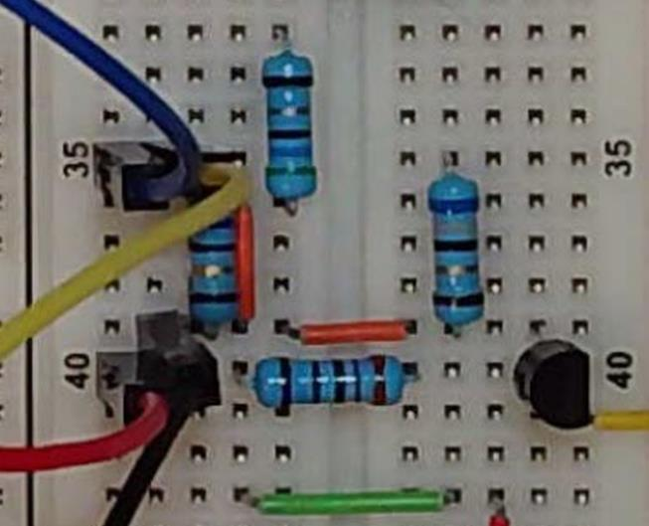
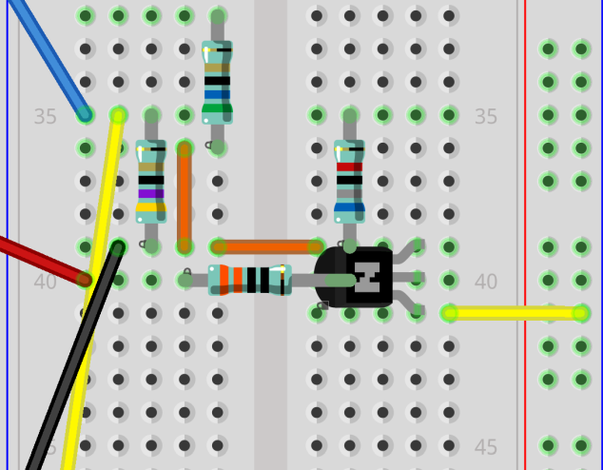
Step 28a – 47Ω Resistor
(1) Blue Flexible Jumper
(1) Yellow Flexible Jumper
(1) Red Flexible Jumper
(1) Black Flexible Jumper

Slide 9
Big Picture of measure_resistor Lab
code.py running on KB2040
measure_resistor.py on Laptop
Waits for a serial (USB) port connection from the laptop
Connects to the KB2040 over the serial (USB) port
Configures i2c_bus, sets DAC to 850 (0.68V), sets ADC into differential mode (A0+, A1-)
Asks user which resistor # (1,2,3) is being measured, sends the string "r" to the KB2040 over USB
NeoPixel is GREEN
Slowly raises ADC from 850 to 950 (0.76V) in 50 steps, averaging 100 samples of the amps and volts at each step
Waits to receive the volts and time samples from the KB2040
Creates a two-column CSV file named "resistor#.csv" containing the average amps and volts for each of the 50 steps of the ADC
Resets DAC to 0 (0V), sets NeoPixel YELLOW, sends the samples over USB

Slide 10
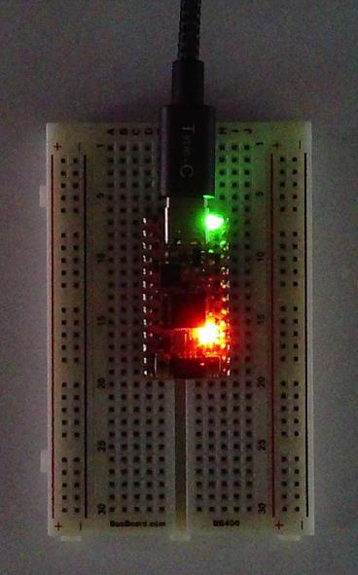
The DAQ device is working…
Measuring circuit voltage over time

Slide 11

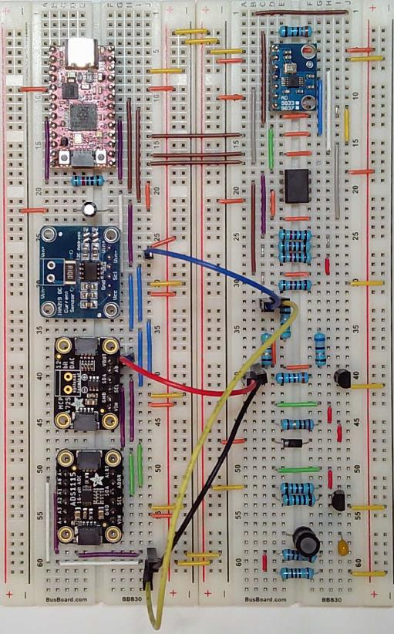
Step28b – 56Ω Resistor

Slide 12
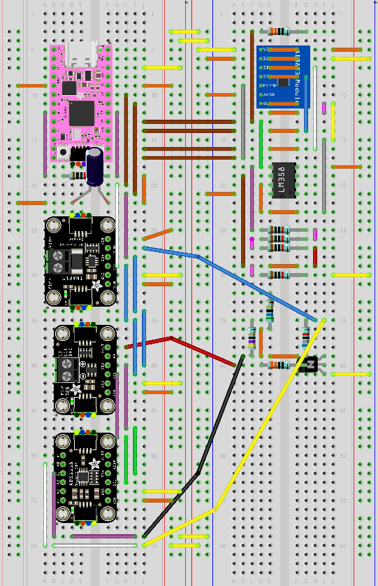
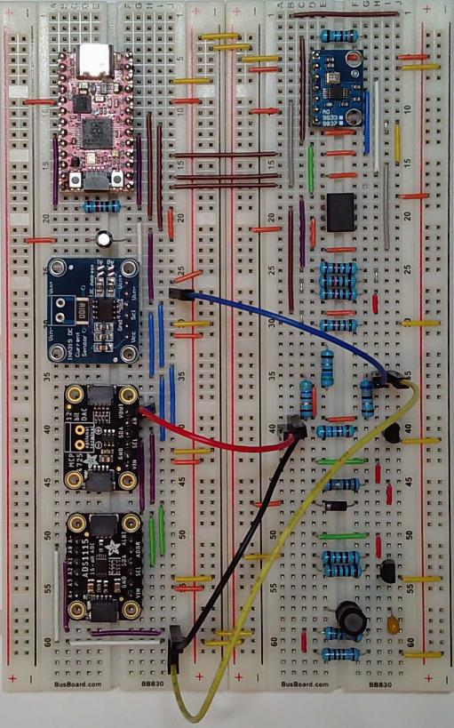
Step 28c – 68Ω Resistor

Slide 13
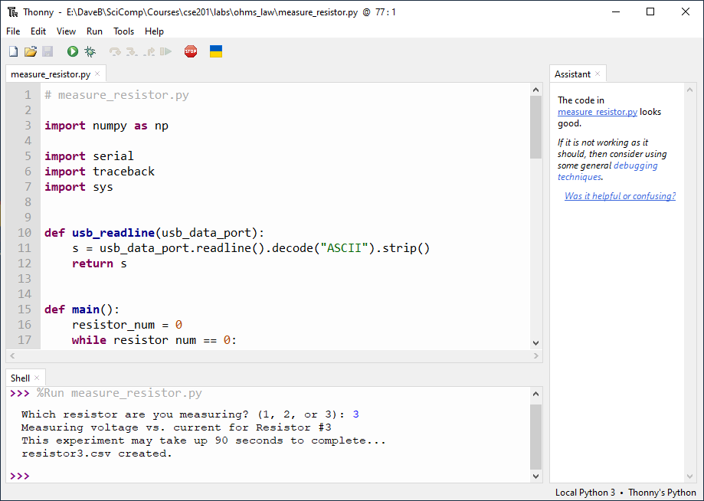
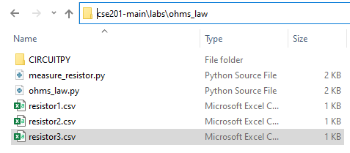
Check measure_resistor.py – 68Ω

Slide 14
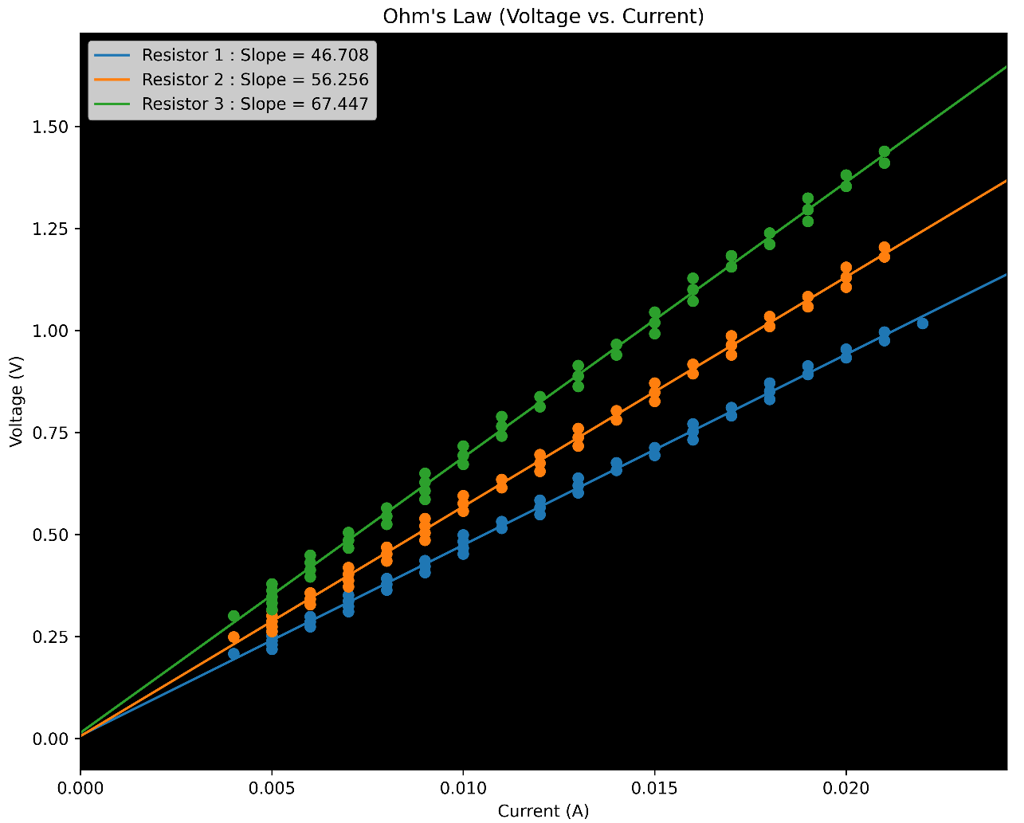
Check ohms_law.py

Slide 15
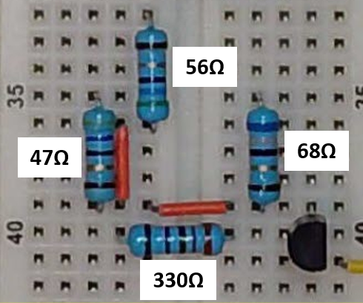

Check ohms_law.py
If R is fixed and current goes to zero, why doesn't voltage go to infinity?
$$R=\frac{V_{R}}{I_{C}}$$

